Slide 1

Unbreakable Randomness: QRNG for Next-Generation Cybersecurity
Segula Cybersecurity Workshop
Presented by: Soheil NAZARI
2025/10/22
iQrypto 2025 – Restricted and proprietary

Slide 2

A Story (or Could This Be You?)
It’s Friday night. A family parks their car for dinner. The system locks automatically — protected by encryption. Everything feels safe…

Slide 3
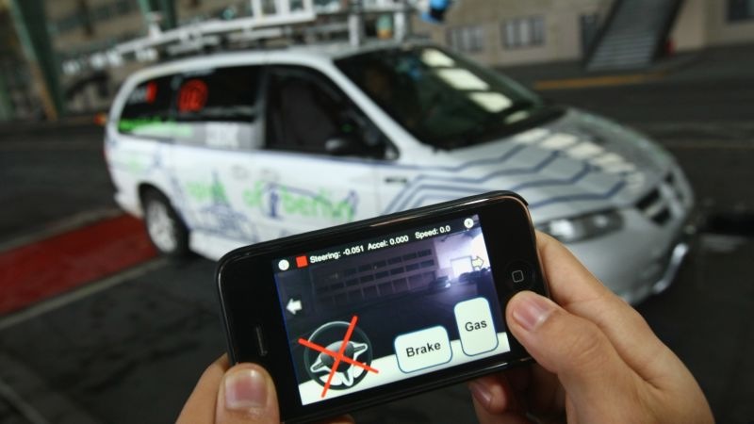
Predictable Random = Predictable Security
But under the hood, their encryption key came from a predictable random seed — generated by software, not nature. In 30 seconds, their ‘randomness’ became an open door
https://www.wired.com/story/kia-web-vulnerability-vehicle-hack-track/

Slide 4

Every crypto decision begins with a number

Slide 5
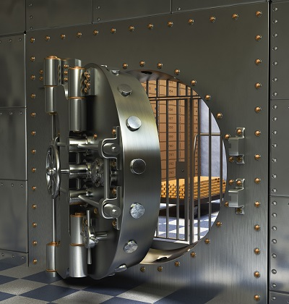
Every crypto decision begins with a number

Slide 6
The Real Problem
Most Random Numbers Aren’t Random
Pseudo-random = predictable
Reused seeds = replayable
Hardware RNG = biased

Slide 7
The Real Problem
Most Random Numbers Aren’t Random
Pseudo-random = predictable
Reused seeds = replayable
Hardware RNG = biased
We trust our systems (cars, payments, authentication)
to numbers that can be guessed.

Slide 8


The Real Problem
Most Random Numbers Aren’t Random
Random.org
PHP pseudo random

Slide 9
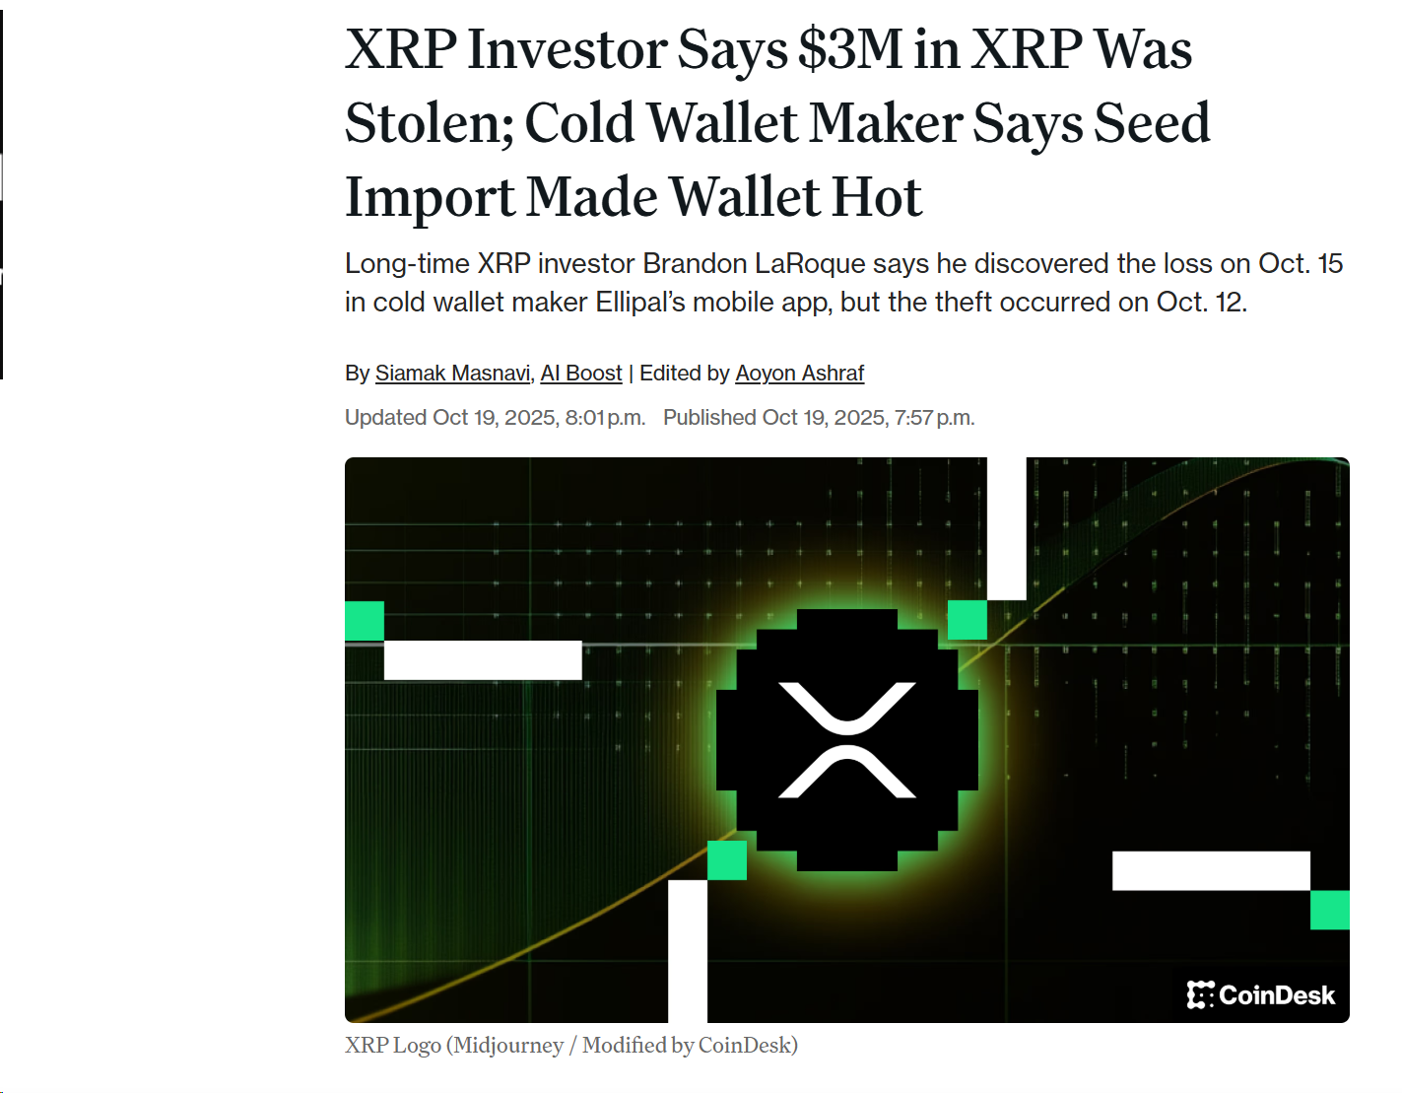
The Case study: $3M XRP theft
XRP hack incident on 12th OCT 2025
https://www.coindesk.com

Slide 10
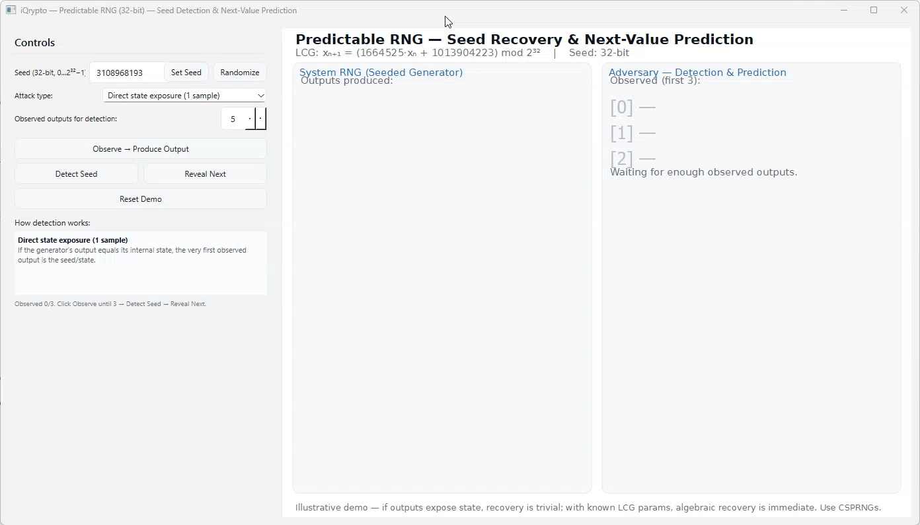
Seed recovery mini-demo

Slide 11
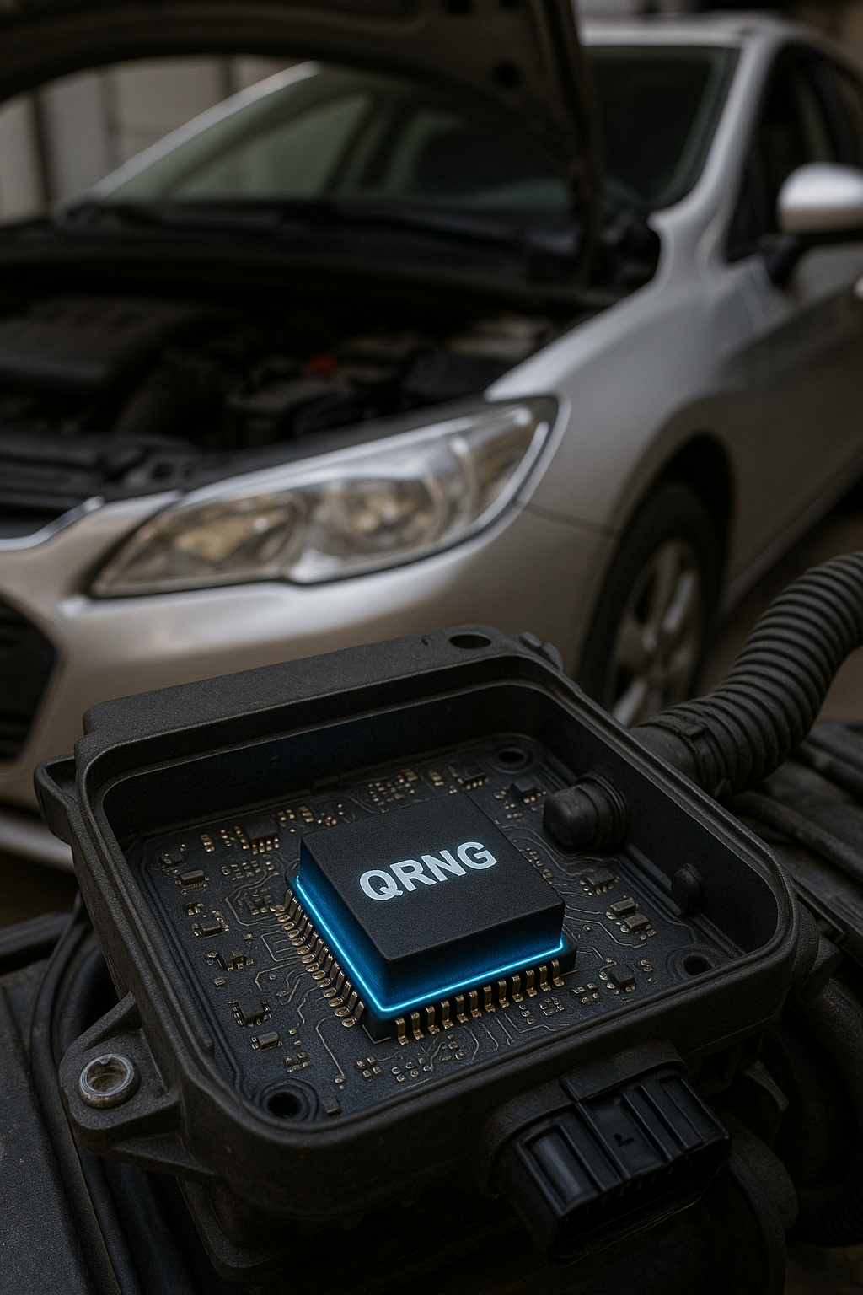
The Solution
Unbreakable Randomness — For the Next Generation

Slide 12
Why Quantum Random Number Generators?
QRNGs harness the inherent unpredictability of quantum phenomena

Slide 13
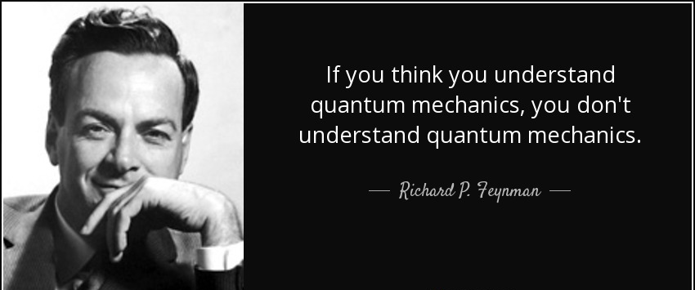
Why Quantum Random Number Generators?

Slide 14
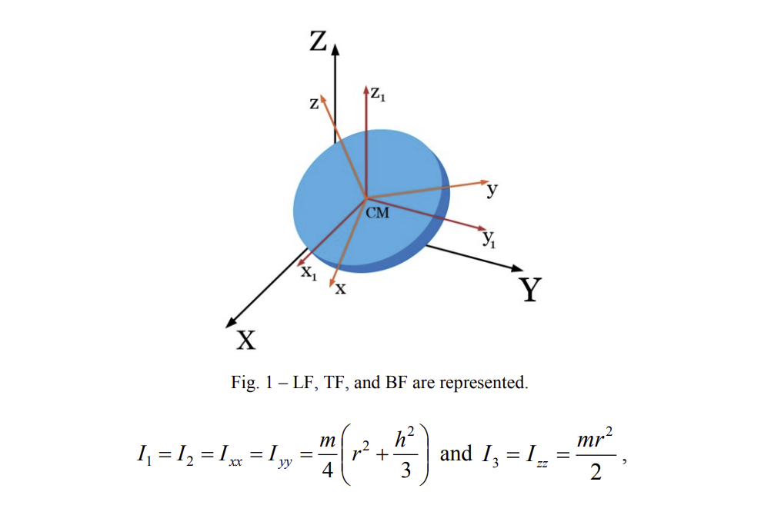
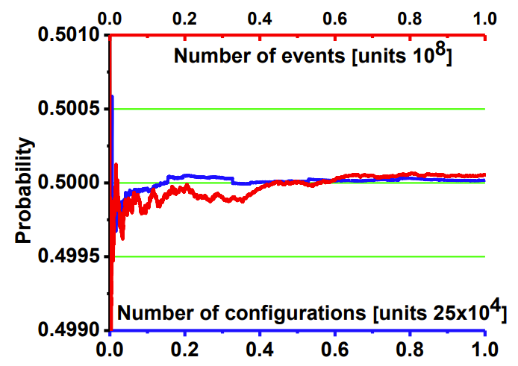
Why Quantum Random Number Generators?
Classical Randomness (Coin Toss)

Slide 15
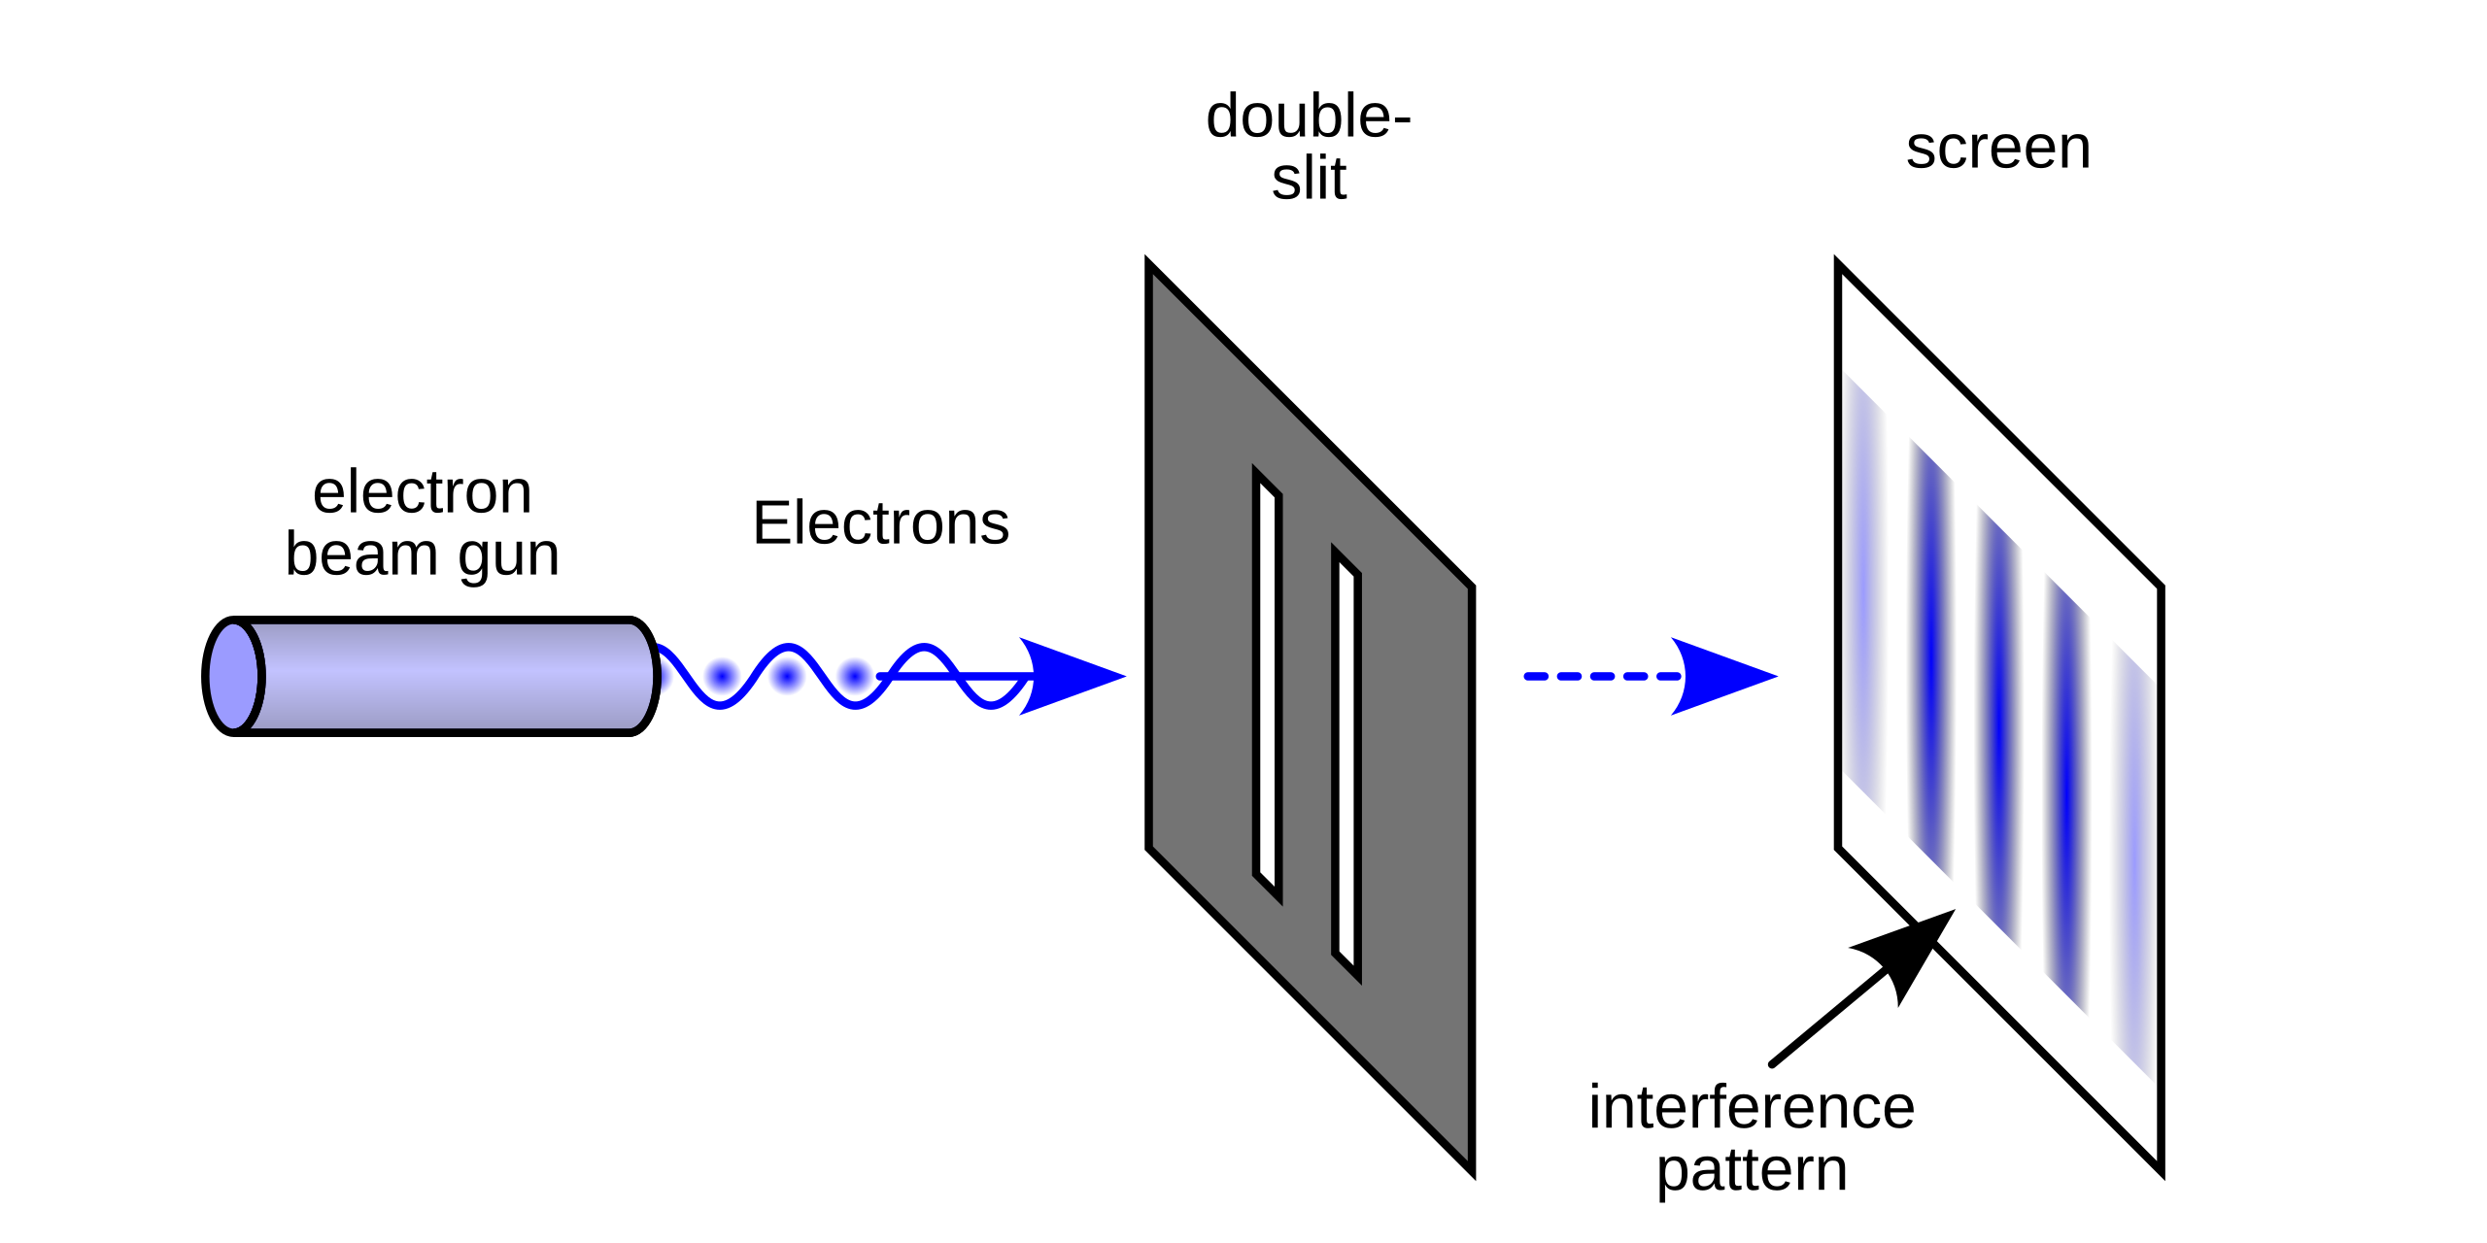
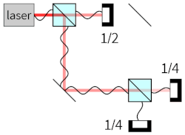
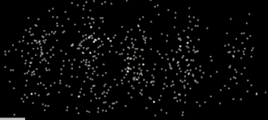
Why Quantum Random Number Generators?
Classical Randomness (Coin Toss)

Slide 16
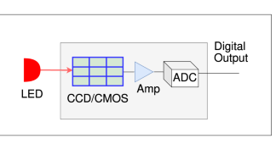
What are the options and how do we make one?

Slide 17
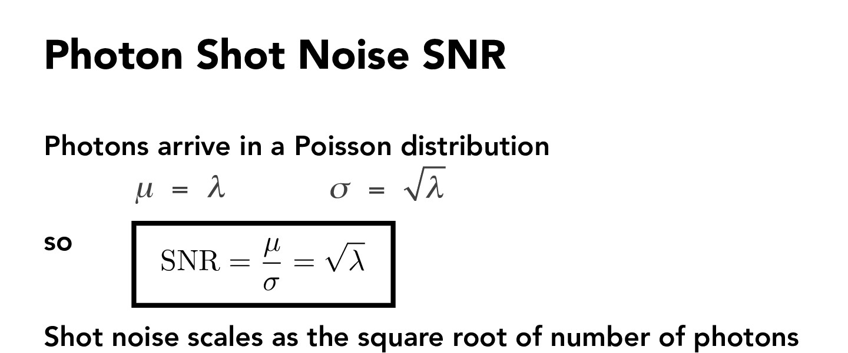
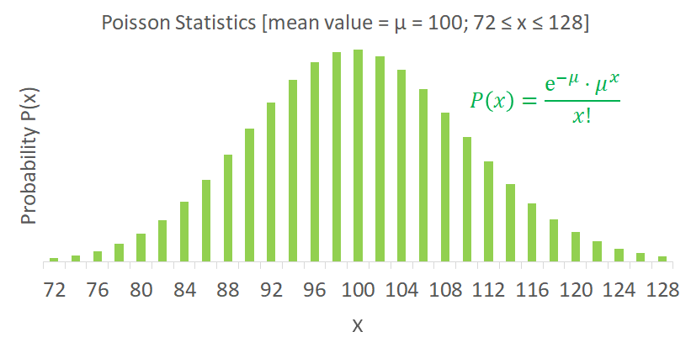
Shot Noise

Slide 18

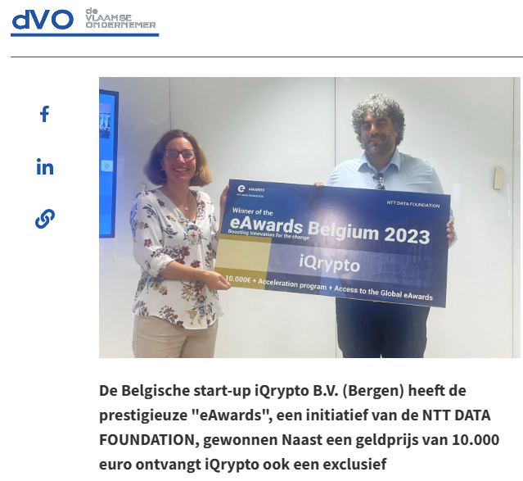









About Us:
Est. 2021
We offer QRNGs and HW/SW systems for interconnection to devices
We’re here!
Supported by:
https://www.dvo.be/artikel/iqrypto-wint-belgische-editie-van-eawards

Slide 19
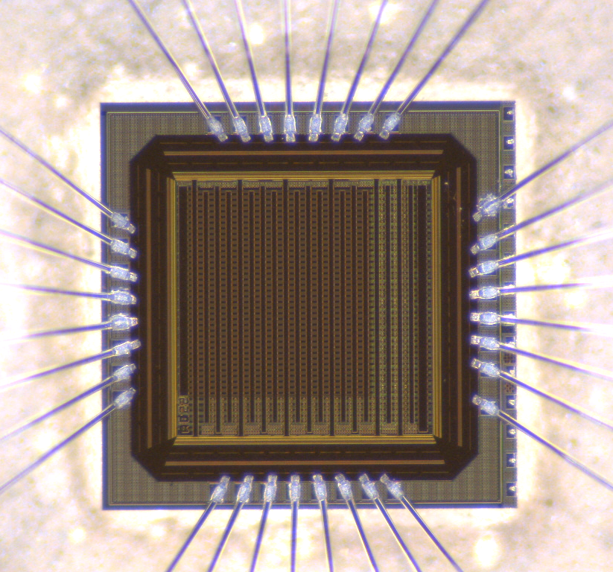
microchip QRNG
1.5 mm

Slide 20
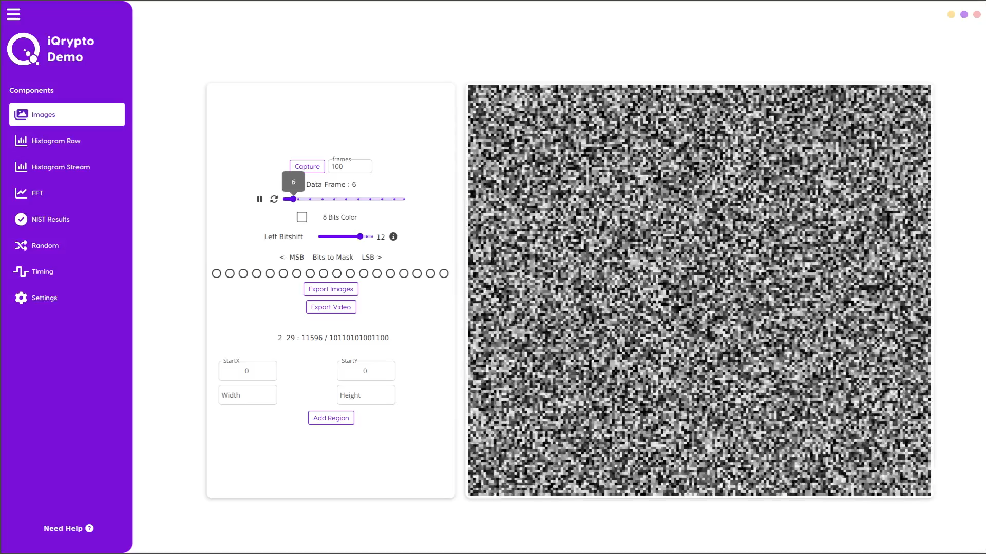
Quantum randomness:
Today’s Private Demo

Slide 21
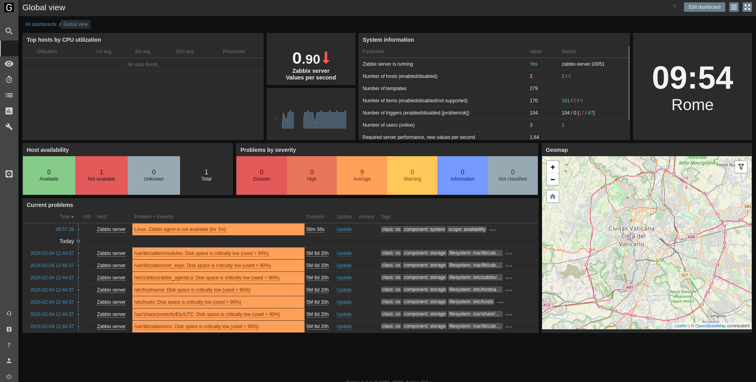
Integration scenario – Lithium battery monitoring:

Slide 22
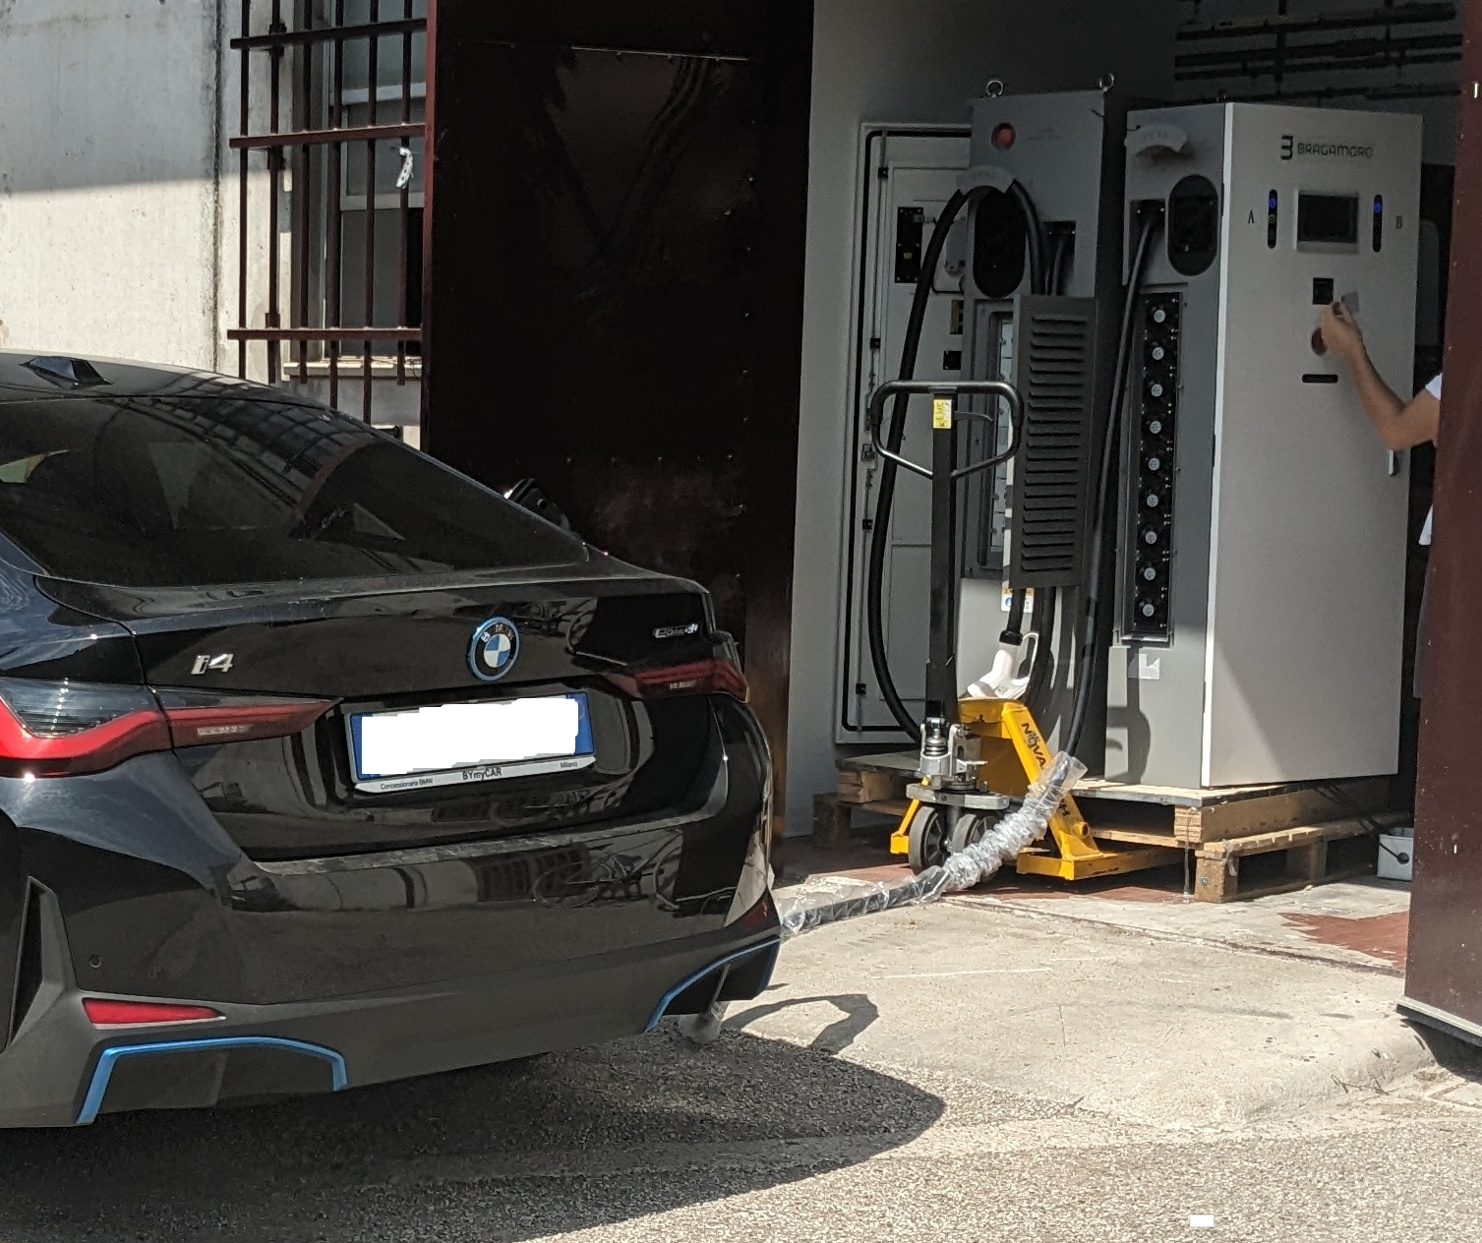
NETQRNG – Electrical Veichle Charging Station
Integrating QRNG capability into EV Charging Stations
Build a better, reliable and resilient EV Charging Infrastructure and Smart Services
Huge market potential

Slide 23


Thank you
See it in action*
* - 5 Spots remains for Nov 2025
They support us:
https://www.linkedin.com/company/iqrypto

