Slide 1
Automotive Android Attack Vectors
Mohammad Hossein Heydarchi

Slide 2


Amazon
Leanpub (ebook)
etc.

Slide 3
Pegasus

Slide 4
More than 50000 phones since 2016
In 50+ countries

Slide 5
2011- present
Android & iOS
iMessage
FaceTime
WhatsApp
Etc.
One-click to zero-click
Often bypassing sandboxing layers
Escalating to kernel-level
Disable security controls

Slide 6
Trident (2016):
One-click Safari → WebKit RCE → kernel infoleak + PE → root → persistent implant → C2.
KISMET (2020):
Zero-click iMessage → userland RCE → sandbox escape + kernel PE → agent stage → stealth ops.
FORCEDENTRY (2021):
Zero-click iMessage image path → BlastDoor bypass → kernel control → agent → cleanup.
BLASTPASS (2023):
Zero-click PassKit/ImageIO → kernel control → agent; mitigated by Lockdown Mode and patches.

Slide 7
TrueType

Slide 8
Out‑of‑Bounds Write
CVSS Score: 8.1 (High / Critical in embedded contexts)
Zero‑click Remote Code Execution (RCE)
Android 13–15 / AAOS 13–15 / Linux Desktop distros
Browsers (Chrome, Firefox, Chromium‑based)
Apple Ecosystem (iOS, macOS, Safari)

Slide 9
Safety & Security

Slide 10
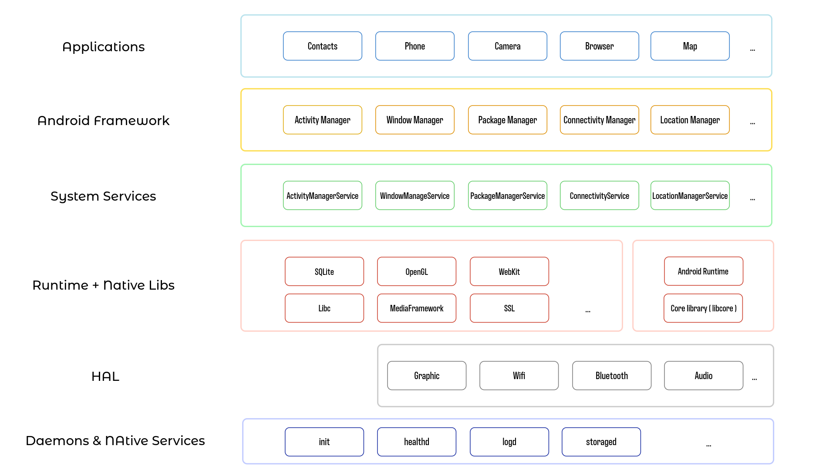

Slide 11
Android Apps Sources
Google
normal
system
OEM/Vendor
normal
privilege
3rd Party
normal
privilege

Slide 12
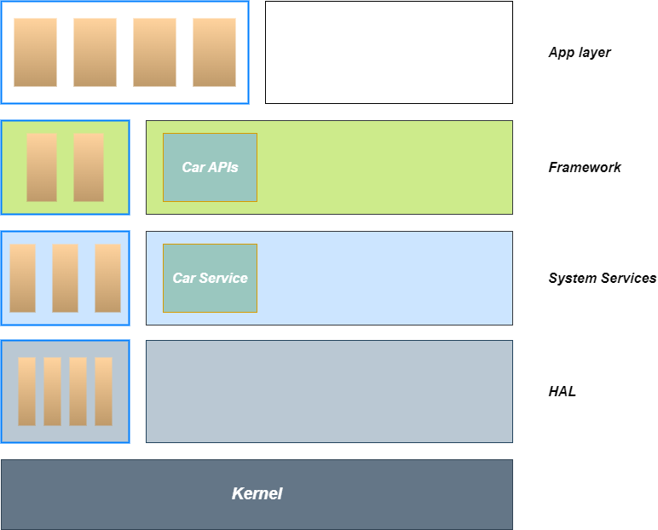

Slide 13
Abbreviation | Definition
RCE | Remote code execution
EoP | Elevation of privilege
ID | Information disclosure
DoS | Denial of service
N/A | Classification not available

Slide 14
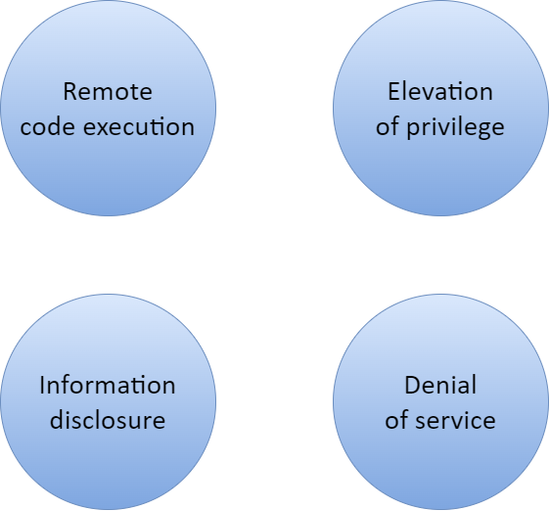

Slide 15
Attack vectors
Android apps
normal/system/privilege apps
Native apps
HAL services
Kernel
Libraries
Daemons
Connection
Android
Native

Slide 16
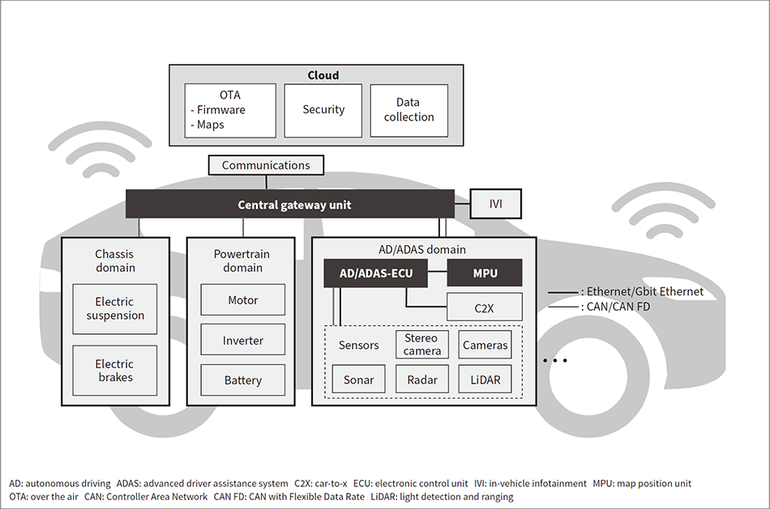

Slide 17
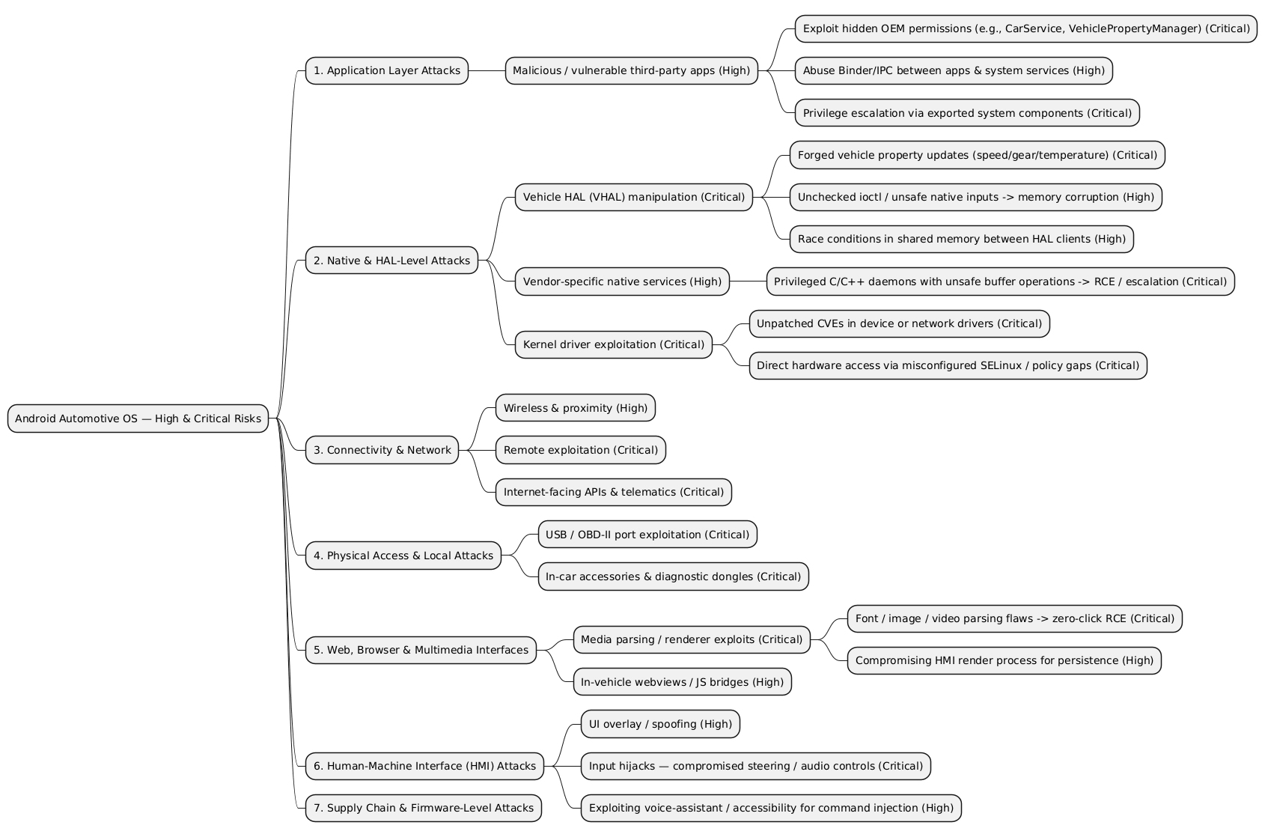
Pitfalls in Automotive
Infrequent Android patches
Old Android version
Design & Architecture
Secure Development Techniques
Insecure protocol
Etc.

