Slide 1


How to Trust a Message:
Authentification of a Ciphertext

Slide 2


Speaker:
Viktor Volke
Cyber Security Epic Owner and Architect at Volvo
IEC62433 assessor and pentester at Riscure
Android and Linux IoT developer
Notes:
2-3 min

Slide 3

History of Trusting
J. H. Ellis 1970 (C. Cocks and M. Williamson 1973) :
@ Government Communications Headquarters, UK
“Possibility of Non-Secret Encryption”
- Public Key Cryptography – all works classified till 1997
Notes:
2 min

Slide 4
History of Trusting
WHITFIELD DIFFIE AND MATRIN HELLMAN
@ IEEE Information Theory Workshop Lenox , MA, June 23-25, 1975
“the equivalent of a written signature”
- apart from key exchange over a public channel
Usage of symmetric key cryptography (!)
Notes:
2 min

Slide 5
History of Trusting
Rivest–Shamir–Adleman 1977
“Digital Signatures and Public-Key Cryptosystems”
- asymmetric key cryptography
RSA Security, Inc 1982
founded Digital Certificates Int. ( VeriSign ) 1995
bought Thawte
Notes:
2 min

Slide 6
History of Trusting
National Institute of Standards and Technology (NIST)
- issued Federal Information Processing Standard
FIPS 186 (1994) : Digital Signature Standard (DSS)
Digital Signature Algorithm (DSA)
- based on PKCS #1 Public-Key Cryptography Standards
  -by RSA Laboratories (1991)
Mark Shuttleworth (Canonical )
founded Thawte 1995
first Certificate Authority to issue public SSL certs outside the US
Notes:
2 min

Slide 7
Why not vanilla symmetric DH 1976:
the scheme only allows signing one bit
(each bit signed separately)
so even with hashing all signature components
– the secret key, the verification combination, and the signature itself
– are quite large in size, > two orders of magnitude larger than the block signed.
signature and verification key pair are one-time applicable
performing the signing procedure of a message bit leads to the disclosure of half of the secret key, after which it is no longer completely secret and cannot be reused. Therefore, each signed message requires its own set of signature and verification keys.
Notes:
2 min

Slide 8
Why not assymmetric DH:
Shared secret only , ie no auth > MITM.
- solved by Ephemeral keys signed by Static keys
- while Static keys identified by thirdparty (CA)
RSA - Integer Factorization.
- Dual_EC_DRBG and weak primes
(RSA received $10 Million bribe from the NSA)
DSA - Discrete logarithm
- cannot encrypt with DSA, only sign, need TRNG (same for ECC)
Math proof exist ? Shortly – no / Quantum – Shor’s
Notes:
2 min

Slide 9
Authentificated encryption today:
Authenticated Encryption (AE) modes :
Authenticated Encryption with Associated Data (AEAD)
      GCM. Galois Counter Mode
      EAX (EAX’ by ANSI is broken)
      CCM. Counter Mode with CBC MAC
      OCB. In performance terms Offset Codebook
        license needed
SSH : Encrypt-and-MAC
TLS : MAC-then-Encrypt
IPSec: Encrypt-then-MAC
- AES CBC, AES CTR, RC4 and most symmetric modes
are insecure for online: adversary can intercept,
tamper and submit ciphertexts to receiver
IND-CPA : Indistinguishability under chosen-plaintext attack
Notes:
2 min

Slide 10
The Importance of PKCS#7:
Establishing Trust
Based on Privacy-Enhanced Mail, PEM
- extension of X.509 standard
of PKI from International Telecommunication Union
Telecommunication Standardization Sector, ITU-T
Foundation for Cryptograghic Message Syntax (CMS)
- standard by Internet Engineering Task Force, IETF
An ENVELOPE for signatures and signed message.
Notes:
2 min

Slide 11
The Importance of PKCS#11:
Anchoring Trust
Plain C API to single-user device (by RSA > OASIS)
Alternatives :
  Trusted Platform Module, ISO standard, HW based
  from TrustedComputingGroup
      utilised by GlobalPlatform (TEE API)
  PSA (Platform Security Architecture) by ARM
- architecture / certification scheme for HW and SW
- much simpler
could be pure SW implemented
OpenSSL wrapper : “Provider” ( “Engine” < ver.3.0 )
Notes:
2 min

Slide 12

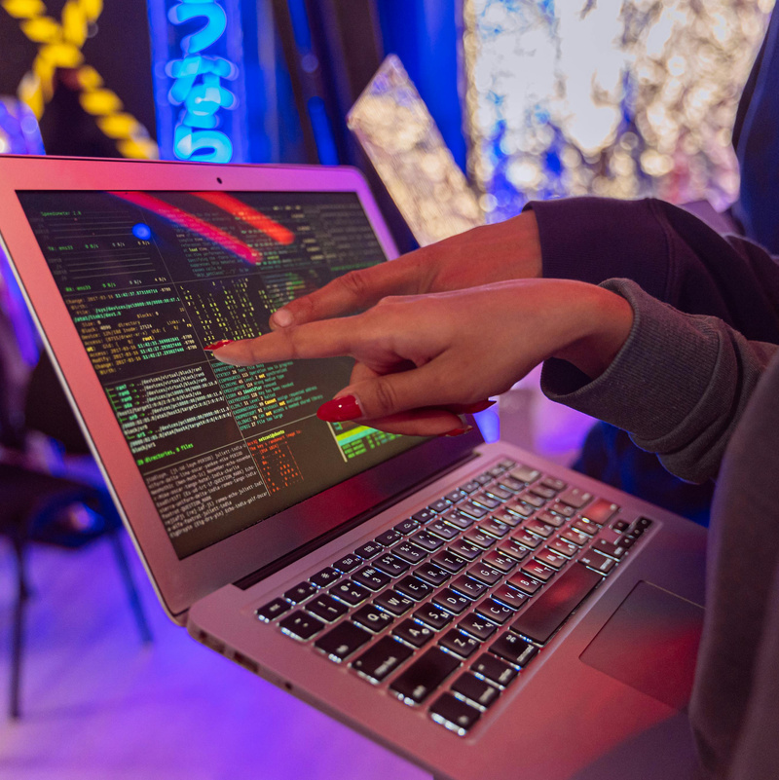
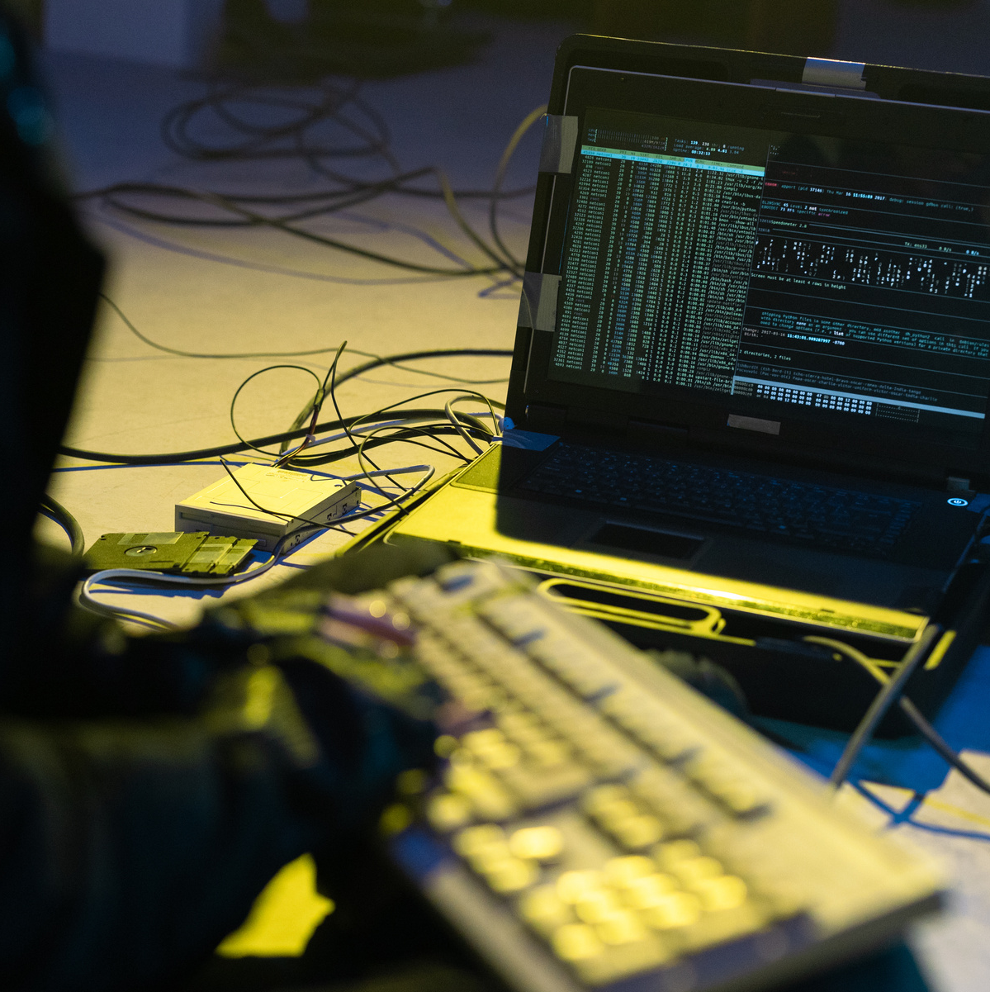
Q&A
Notes:
2 min

